Slide 1
Chapter 7: Fundamental Printers and Scanners
IT Essentials: PC Hardware and Software v4.1
Notes:
Cisco Networking Academy Program
IT Essentials: PC Hardware and Software v4.1
Chapter 7: Fundamental Printers and Scanners

Slide 2
Chapter 7 Objectives
7.1 Describe the types of printers currently available
7.2 Describe the installation and configuration process for printers
7.3 Describe the types of scanners currently available
7.4 Describe the installation and configuration process for scanners
7.5 Identify and apply common preventive maintenance techniques for printers and scanners
7.6 Troubleshoot printers and scanners
Notes:
Chapter 7 Objectives
The purpose of this chapter is to provide essential information about printers and scanners. The topics include how printers operate, what to consider when purchasing a printer, and how to connect printers to an individual computer or to a network.
7.1 Describe the types of printers currently available
7.2 Describe the installation and configuration process for printers
7.3 Describe the types of scanners currently available
7.4 Describe the installation and configuration process for scanners
7.5 Identify and apply common preventive maintenance techniques for printers and scanners
7.6 Troubleshoot printers and scanners

Slide 3
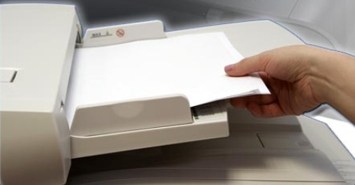
Introduction
Printers produce paper copies of electronic files.
  Hard copies of computer documents remain important today.
Scanners allow users to convert paper documents into
electronic files.
Notes:
7.0 Chapter Introduction
Printers produce paper copies of electronic files.
Scanners allow users to convert paper documents into electronic files.
Many government regulations require physical records; therefore, hard copies of computer documents are often as important today as they were when the paperless revolution began several years ago.
A technician must understand the operation of various types of printers and scanners to be able to install and maintain them, as well as troubleshoot any problems that may arise.
After completing this chapter, students will meet these objectives:
Describe the types of printers currently available
Describe the installation and configuration process for printers
Describe the types of scanners currently available
Describe the installation and configuration process for scanners
Identify and apply common preventive maintenance techniques for printers and scanners
Troubleshoot printers and scanners

Slide 4
Printers
As a computer technician, you may be required to purchase, repair, or maintain a printer.
Printer selection criteria:
  Capacity and Speed
  Color
  Quality
  Reliability
    Warranty
    Scheduled servicing
    Meat time between failures (MTNF)
Total Cost of Ownership (TCO)
Notes:
7.1 Describe the types of printers currently available
As a computer technician, you may be required to purchase, repair, or maintain a printer. The following are tasks that a customer may request from you:
Select a printer
Install and configure a printer
Troubleshoot a printer
7.1.1 Describe characteristics and capabilities of printers
Printers available today are usually either laser printers using electrophotographic technology or inkjet printers using electrostatic spray technology. Dot matrix printers using impact technology are used in applications that require carbon copies.
Printer capacity and speed are factors to consider when selecting a printer. Inkjet printers are usually slower, but they may be adequate for a home or small office. The speed of a printer is measured in pages per minute (ppm).
Price of a printer reflects its capacity and speed
A computer monitor produces colors through the additive mixing of dots that are displayed on the screen. The eye picks up the colors directly. The dots produce the color range using red, green, and blue (RGB) dots.
A printer produces colors using subtractive mixing. The eye sees a color that reflects from the combination of colors on the paper. The colors are cyan, magenta, yellow, and black (CMYK).
The choice between a black-and-white printer and a color printer depends on the needs of customers:
Quality is measured in dots per inch (dpi).
The more dpi, the higher the resolution
Higher resolution means text and images are usually clearer
To take advantage of high resolution, use high-quality ink or toner and high-quality paper

Slide 5
Printer to Computer Interfaces
To access a printer, a computer must have an interface with it. The following are common interface types:
  Serial
  Parallel
  Small Computer System Interface (SCSI)
  Universal Serial Bus (USB)
  Firewire
  Ethernet
  Wireless
    Infrared
    Bluetooth.
    Wi-Fi
Notes:
7.1.2 Describe printer to computer interfaces
To access a printer, a computer must have a compatible interface with the printer. The following are common interface types:
Serial data transfer is the movement of single bits of information in a single cycle
Serial ports are D-shell and are either male or female ports
The number of pins for each port may vary. Serial cables may have either a 9-pin connector or a 25-pin connector either end
The maximum length of a serial cable is 50 ft (15 m).
Parallel data transfer is the movement of multiple bits of information in a single cycle
Parallel data transfer is faster than serial data transfer
IEEE 1284 is the current standard for parallel printer ports. Enhanced Parallel Port (EPP) and Enhanced Capabilities Port (ECP) are two modes that allow bi-directional communication. IEEE 1284 standard allows for cable length up to 30 ft (10 m); for data reliability, 15 ft (4.5 m) cable lengths are recommended. Parallel cables may have a 1284 Type-A 25-pin DB 25 connector on one end, and a 36-conductor Centronics connector on the other end. The Type-A connector connects to a computer, while the Centronics connector connects to a printer.
Small Computer System Interface (SCSI), pronounced “scuzzy”, uses parallel communication to achieve high data-transfer rates. Some types of SCSI:
SCSI 1 - 50 pin connector
SCSI 2 (fast SCSI) - 50 pin connector
SCSI 2 (wide SCSI) - 68 pin connector
SCSI 3 (fast/wide SCSI) - 68 pin connector
Universal Serial Bus (USB) is a common interface for printers and other devices
Speed and simple setup has made USB very practical. Newer operating systems offer plug and play (PnP) USB support, which automatically detects the device and installs the driver.
A USB printer cable is a four-wire cable that has two unique ends, labeled A and B. Rectangular A connector usually connects with the computer. Square-shaped B connector connects to the printer.
127 USB devices can attach to a single bus.
Firewire - Also known as i.LINK or IEEE 1394, is a high-speed, communication bus that is platform independent
Firewire connects devices such as printers, scanners, cameras
Allows a peripheral device to seamlessly plug into a computer
Devices are hot-swappable
A single plug-and-socket connection can attach up to 63 devices
Has a data transfer rate of up to 400 Mbps
Ethernet - An interface for network printers.
Network printers are usually a resource shared on a network
Typically have high-speed output and options such as LAN fax, duplex, and finishers
Most have an RJ-45 interface for an Ethernet connection
Infrared - For infrared communication to take place between a printer and a computer:
Transmitters and receivers are required on both devices
Must be a clear line of sight between the transmitter and receiver
Maximum distance of 15 ft (4.5 m)
Infrared light is invisible to the human eye
Bluetooth technology uses an unlicensed radio frequency for short-range communication
Popular for wireless headsets and synching PDAs to computers
Bluetooth adapter will allow a Bluetooth device to connect to a printer, usually by using a USB port
Wi-Fi or IEEE 802.11 - A standard for wireless communication. There are two common standards:
802.11b transfers data at a rate of 11 Mbps
802.11g transfers data at a rate of 54 Mbps. 802.11g products are backwards compatible with 802.11b

Slide 6
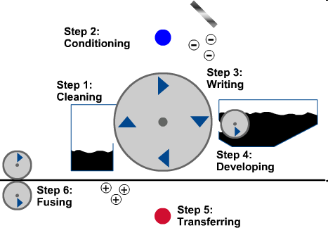
Laser Printers
A laser printer is a high-quality, fast printer that uses a laser beam to create an image.
Laser printing process
  Cleaning
  Conditioning
  Writing
  Developing
  Transferring
  Fusing
WARNING: The primary corona wire or grid, or the conditioning roller, can be very dangerous. The voltage runs as high as -6000 volts. Only certified technicians should work on the unit. Before working inside a laser printer, you should make sure that voltage is properly discharged.
Notes:
7.1.3 Describe laser printers
The central part of the laser printer is its electrophotographic drum. When laser light strikes the drum, it becomes a conductor at the point where the light strikes. The laser beam draws an electrostatic image on the drum. The undeveloped image is passed by a supply of dry ink or toner that is attracted to it. The drum turns and brings this image in contact with the paper, which attracts the toner from the drum. A fuser melts the toner into the paper.
There are seven main components contained within a laser printer:
Toner cartridge
Laser scanner
High-voltage power supply
Paper transport mechanism
Transfer corona
Fuser assembly
Control circuitry
Ozone filter
NOTE:
You should know the components of a laser printer and the steps required to print a page.
Laser Printing Process
The laser printer process involves six steps to print information onto a single sheet of paper.
Step 1: Cleaning - When an image has been deposited on the paper and the drum has separated from the paper, any remaining toner is removed from the drum. Printer may have a blade that scrapes excess toner from drum. Some printers use an AC voltage on a wire that removes the charge from the drum surface and allows the excess toner to fall away from the drum.
Step 2: Conditioning - Removing the old latent image from the drum and clearing the drum for a new image. Done by placing a special wire or grid, called the primary corona, across the surface of the drum. Drum receives a negative charge of approximately -600 volts DC. The roller is called a conditioning roller.
Step 3: Writing - Scanning the photosensitive drum with the laser beam. Every portion of the drum that is exposed to the light has the surface charge reduced to about -100 volts DC. As the drum turns, an invisible latent image is created on it.
Step 4: Developing - Toner is applied to the latent image. Toner contains developer particles made up of magnetic materials coated with a plastic-like material. The toner is charged to approximately -200 volts DC. Toner is attracted to the -100 volts DC areas of the photosensitive drum, but repelled by the more negative -600 volts DC areas. A control blade holds the toner at a microscopic distance from the drum. The toner leaps from the control blade to the drum, where it is attracted by the more positively charged latent image.
Step 5: Transferring - Toner attached to the latent image is transferred to the paper. Secondary corona places a positive charge on the paper. Paper attracts the negative toner image from the drum. The image is now on the paper, held in place by the positive charge.
Step 6: Fusing - Paper is rolled between a heated fuser roller and a pressure roller. Fuser roller is heated to about 350 degrees Fahrenheit (177 degrees Celsius). Loose toner powder fuses with the fibers in the paper. Paper is then moved to the output tray as a printed page.
[This mnemonic will help you to memorize the order of the steps in laser printing: Continuous Care Will Delay Trouble Forever.]

Slide 7
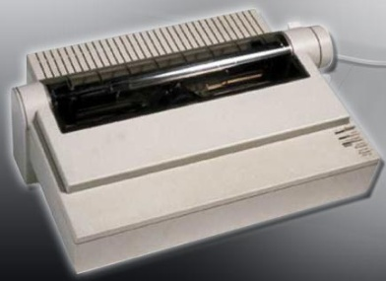
Impact Printers
  Impact printers use a print head impacts a printer tape or inked ribbon to create characters.
  There are two types:
    Daisy-wheel
    Dot-matrix
  They use inexpensive consumables and have carbon copy printing ability. Unfortunately they are also noisy, have lower graphic resolution and limited color capabilities.
Notes:
7.1.4 Describe impact printers
Impact printers form characters when the print head impacts a printer tape or inked ribbon to create characters. Examples of impact printers are Dot-matrix and Daisy-wheel.
Advantages of an impact printer:
Uses inexpensive consumables (ink ribbons)
Uses continuous feed paper
Has copy printing ability (“carbon copies”)
Disadvantages of an impact printer:
Noisy
Low resolution graphics
Limited color capability
Slow printing, normally 32 to 76 characters per second (cps)
Daisy-wheel printer - The wheel contains the embossed letters, numbers, and special characters. Wheel is rotated until the required character is in place, and an electromechanical hammer pushes the character into the ink ribbon and against the paper.
Dot-matrix printer - Print head contains pins that are surrounded by electromagnets. When the electromagnets are energized, the pins push forward onto the ink ribbon in patterns, forming a character. The number of pins on a print head, 9 or 24, indicates the quality of the print. The highest quality of print that is produced by the dot matrix printer is referred to as near letter quality (NLQ). Most dot-matrix printers use continuous feed paper with perforations between each sheet.

Slide 8
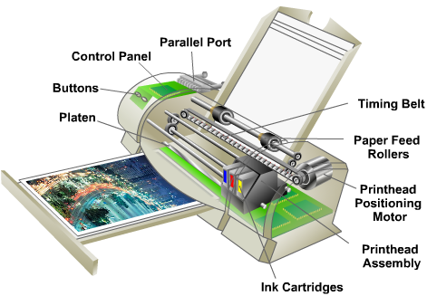
Inkjet Printers
Use ink-filled cartridges that spray ink onto a page through tiny holes, or nozzles. The ink is sprayed in a pattern on the page, one column of dots at a time.
Two types of inkjet nozzles:
  Thermal
  Piezoelectric
They produce high quality print, are easy to use and are less expensive than laser printers. However the nozzles are prone to clogging and the ink is wet after printing.
A feeding mechanism draws paper in and the paper passes by the print head where ink is sprayed onto it.
Notes:
7.1.5 Describe inkjet printers
Inkjet printers produce high quality print. Inkjet printers are easy to use and inexpensive compared to laser printers.
There are two types of inkjet nozzles:
Thermal - A pulse of electrical current is applied to heating chambers around the nozzles. The heat creates a bubble of steam in the chamber which forces ink out through the nozzle.
Piezoelectric crystals are located in the ink reservoir at the back of each nozzle. A charge is applied to the crystal causing it to vibrate. This vibration of the crystal controls the flow of ink onto the paper.
Inkjet Printer Components
Printer paper is drawn into the printer by a feeding mechanism. Paper passes by the print head where ink is sprayed onto it. Paper leaves the printer through the discharge mechanism, and is wet for about 15 seconds.
Inkjet printers use plain paper to make economical prints. Special-purpose paper may be used to create high-quality prints of photographs.
Print quality of an inkjet printer is measured in dots per inch (dpi). A higher dpi rating provides greater image detail.
Advantages of an inkjet printer:
Low cost
High resolution
Quick to warm up
Disadvantages of an inkjet printer:
Nozzles are prone to clogging
Ink cartridges are expensive
Ink is wet after printing

Slide 9
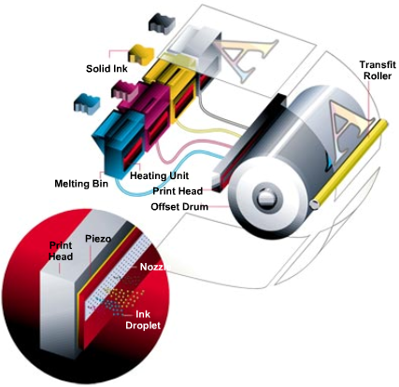
Solid-ink Printers
Use solid sticks of ink rather than toner or ink cartridges.
The printing process:
  Cleaning
  Spraying
  Transferring
This type of printers produce vibrant color prints and can use many different paper types.
The printer and the ink used are normally expensive and they are slow to warm up.
Notes:
7.1.6 Describe solid-ink printers
Solid-ink printers use solid sticks of ink rather than toner or ink cartridges. Solid-ink printers produce high-quality images. The ink sticks are nontoxic and can be handled safely. Solid-ink printers melt ink sticks and spray the ink through nozzles. The ink is sprayed onto a drum. The drum transfers the ink to paper.
The printing process in a solid-ink printer is a three-stage process:
Step 1: Cleaning - Drum surface is cleaned to remove any remaining ink from the previous print.
Step 2: Spraying - The print head and the drum are heated and an image is sprayed onto the print drum.
Step 3: Transferring - Paper is passed between a pressure roller and the drum transferring the image to the paper. The ink is dry when the transfer is finished.
Advantages of solid-ink printers:
Produces vibrant color prints
Easy to use
Can use many different paper types
Disadvantages of solid-ink printers:
Printers are expensive
Ink is expensive
They are slow to warm up

Slide 10
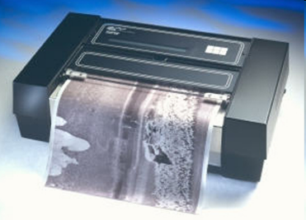
Thermal Printers
A thermal printer uses chemically-treated paper that becomes black when heated.
A thermal transfer printer uses heat-sensitive ribbon, which the print head melts onto the paper.
Thermal printers have a longer life because there are few moving parts.
Disadvantages:
  Paper is expensive
  Paper has a short shelf life
  Images are poor quality
  Paper must be stored at
  room temperature
Notes:
7.1.7 Describe other printer types
Two other printing technologies that you may work with are thermal and dye-sublimation.
Thermal Printer - The paper used in these printers is chemically treated and has a waxy quality. Thermal paper becomes black when heated.
Most thermal printer print heads are the width of the paper. Areas of the print head are heated as required to make the pattern on the paper.
Paper is supplied in the form of a roll. Some retail cash registers or older fax machines contain thermal printers.
A type of thermal printer is a thermal transfer printer, which uses heat-sensitive ribbon that the print head melts onto the paper.
An advantage of a thermal printer:
Longer life because there are few moving parts
A disadvantage of a thermal printer:
Paper is expensive
Paper has a short shelf life
Images are poor quality
Paper must be stored at room temperature

Slide 11
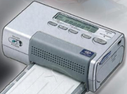
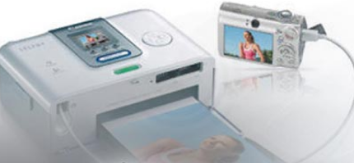
Dye-Sublimation Printers
Also called thermal dye printers
Usually used in producing photo-quality images for graphic printing
Uses solid sheets of ink that change directly from solid to gas when heated, in a process called sublimating
Advantages:
  Very high quality images
  Overcoat layer reduces smearing, increases moisture resistance
Disadvantages:
  Media can be expensive
  They are better for color than for grayscale (black and white)
Notes:
7.1.7 Describe other printer types
Dye-Sublimation or thermal dye printers are usually used in producing photo-quality images for graphic printing.
Uses solid sheets of ink that change directly from solid to gas when heated, in a process called sublimating. The gas passes through the paper, where it turns back to a solid. The print head passes over a sheet of cyan, magenta, yellow, and a clear overcoat (CMYO). There is a pass for each color.
Advantages of dye-sublimation printers:
Very high quality images
Overcoat layer reduces smearing, increases moisture resistance
Disadvantages of dye-sublimation printers:
Media can be expensive
They are better for color than for grayscale (black and white)
In photography, both dye-sublimation printers and small color ink-jet printers provide quality prints.

Slide 12
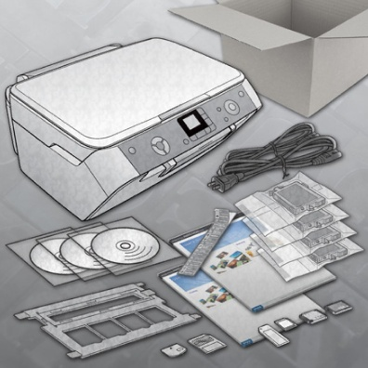
Installation and Configuration of Printers
When purchasing a printer, the installation and configuration information is usually supplied by the manufacturer:
An installation media that includes drivers, manuals, and diagnostic software.
Also available as downloads from the manufacturer's website.
Although all types of printers are somewhat different to connect and configure, there are procedures that should be applied to all printers.
Notes:
7.2 Describe the installation and configuration process for printers
When you purchase a printer, the installation and configuration information is usually supplied by the manufacturer. An installation CD that includes drivers, manuals, and diagnostic software will be included with the printer. The same tools may also be available as downloads from the manufacturer's website
7.2.1 Describe how to set up a printer
Go through this checklist to prepare the printer for installation:
Once the printer has been unpacked and placed in position, connect it to the computer, network, or print server and plug it into an electrical outlet.
Check the box to ensure all required cables are provided.
Remove packing materials from the printer and plastic inserts from the consumables.
Place printer in position. Ensure that the printer location will not cause overheating.
Install the toner or ink cartridge in the printer.
Install paper trays.
Install paper.
Read and follow the instruction manual.
Connect cables.
Test print from computer.

Slide 13
Installation and Configuration of Printers (Continued)
Power and Connect the Printer
  Connect the appropriate data cable to the communication port on the back of the printer.
  Warning: Never plug a printer into a UPS. The power surge that occurs when the printer is turned on will damage the UPS unit.
Printer Driver
  Printer driver is the software program that enables the computer and the printer to communicate with each other.
  It is recommendable to find out if a newer driver is available on the manufacturer’s website.
Firmware
  Set of instructions stored on the printer to control how the printer operates.
  If printing problems occur or you need new features, consider upgrading the printer's firmware.
Notes:
7.2.2 Explain how to power and connect the device using a local or network port
If the printer has a USB, Firewire, or Parallel port, connect the corresponding cable to the printer port and to the corresponding port on the back of the computer. The local computer manages and sends the print jobs to the printer. Local printers can be shared over the network with other users.
If you are installing a network printer, connect the network cable to the network port. Most network connections use an Ethernet cable. The network printer allows multiple users to send documents to the printer over the network
7.2.3 Describe how to install and update the device driver, firmware, and RAM
After you have connected the power and data cables to the printer, the operating system may discover the printer and attempt to install a driver. If you have a driver CD from the manufacturer, install the driver software from the manufacturer. The driver that is included with the printer is usually more current than the drivers used by the operating system.
Printer drivers are software programs that enable the computer and the printer to communicate with each other. Drivers also provide an interface for the user to configure printer options. Every printer model has a unique driver. Printer manufacturers frequently update drivers. You can download new printer drivers from the manufacturer's website.
Step 1: Find out if a newer driver is available on the manufacturer’s website.
Step 2: Download the driver files to your computer.
Step 3: Install the driver automatically or manually.
Step 4: Test the new printer driver.
Firmware is a set of instructions stored on the printer to control how the printer operates. You may wish to upgrade your printer's firmware if you encounter printing problems or need new features. The procedure to upgrade firmware is very similar to installing printer drivers. Download the upgrade file from the manufacturer's website and run a setup file that installs it.

Slide 14
Installation and Configuration of Printers (Continued)
Printer Memory
  Printer memory is used to buffer print jobs, create pages, or draw images for documents.
  Adding printer memory can improve printing speed and allow the printer to handle more complex print jobs.
Configuration Options and Default Settings
  Printers have different configurations and default options. Check the printer documentation for details.
Optimize Printer Performance
  With printers, most optimization is completed through the software supplied with the drivers (Print spool, calibration, orientation).
Notes:
7.2.3 Describe how to install and update the device driver, firmware, and RAM
All printers have some memory. Adding printer memory to a printer can improve printing speed and allow the printer to handle more complex print jobs.
Print-job buffering is the ability of the printer to capture as much of the print job into its internal memory as possible. The computer can focus on other tasks instead of waiting to send the remaining data of the print job to the printer. Buffering is common on laser printers, and plotters, as well as on high-end inkjet and dot-matrix printers.
The page creation process of the laser printer enables the printer to prepare an entire page before printing it. This allows the printer to print while creating the next page.
Consult the printer documentation for memory requirements:
Memory specifications
Memory population and availability
While each printer may differ, the following are generic steps to upgrade memory.
Turn off the printer.
Disconnect all cables.
Open the memory compartment.
Replace memory modules or add new modules.
Close the memory compartment.
Reconnect all cables.
Power on printer.
Run a self-test.
Print a test page.
7.2.4 Identify configuration options and default settings
Common configurations that are available for printers:
Paper type - standard, draft, gloss, or photo
Print quality - draft, normal, photo, or automatic
Color printing - multiple colors are used
Black-and-white printing - only black ink is used
Grayscale printing - color image printed with shades of black ink
Paper size - standard and nonstandard paper sizes
Paper orientation - landscape or portrait
Print layout - normal, banner, booklet, or poster
Duplex - normal or two-sided printing
7.2.5 Describe how to optimize printer performance
In the software, there are tools available to optimize performance:
Print spool settings - You can store documents that are prepared for printing in a file in RAM called the print spool. You can cancel or pause print jobs in the printer queue. Spooling programs allow the application you are printing from to finish faster. You may also print directly to the printer
Printer calibration - You can adjust settings to match the colors seen on the screen and the colors on printed sheet
Paper orientation – You can select landscape or portrait image layout.

Slide 15
Installation and Configuration of Printers (Continued)
Test Page Printing
  After installing a printer, you should print a test page to verify that the printer is operating properly.
  You can print a test print manually, from an application such as Notepad , from the Command Line or from the printer front panel.
Printer Sharing
  It enables multiple network users or clients to access a printer. This reduces the expense, as fewer printers are required. Windows 2000/XP installs the print sharing capability in the basic setup.
Notes:
7.2.6 Describe how to print a test page
After installing a printer, you should print a test page to verify the following:
The printer is operating properly
The driver software is installed and working correctly
The printer and computer are communicating
To print a test page manually, use the following path:
Start > Printers and Faxes (Windows XP)
Start > Printers (Windows Vista)
This will display the Printers and Faxes window. Right-click the desired printer and follow this path:
Properties > General Tab > Print Test Page. A dialog box will open, asking if the page printed correctly. If it did not, then built-in Help will assist you in troubleshooting the problem.
To print from an Application such as Notepad:
Start > Programs > Accessories > Notepad (both Windows XP and Vista). A blank document will open. Enter some text in the document. Print it using the following path:
File > Print
Test a Printer from the Command Line
Printing from the command line is limited to ASCII files only, such as .txt and .bat files.
To send a file to the printer from the command line, use this path:
Start > Run (Windows XP)
Start > Start Search (Windows Vista)
The Run box should pop up. Type cmd in the Run box, and then click OK.
At the command line prompt, enter the following command: Print thefile.txt
Test Printer from Printer Panel
Most printers have a front panel with controls to allow you to generate test pages. This method of printing enables you to verify the printer operation separately from the network or computer. Consult the printer manufacturer's website or documentation to learn how to print a test page from the front panel of the printer.
7.2.7 Describe how to share a printer
Setting up printer sharing is simple with Windows XP. The following steps enable a computer to share a printer:
Click Start > Printers and Faxes (Windows XP)
Click Start > Control Panel > Printers (Windows Vista)
Right-click the printer and choose Properties.
Select the Share tab.
Click the Share this printer radio button.
You may keep or change the share name.
Click Apply.
All of the computers that use the shared printer must have the correct drivers installed. Drivers for other operating systems can be installed on the print server. Click Additional Drivers… and select the relevant drivers.
To connect to the shared printer from another computer on the network:
Choose Start > Printers and Faxes > Add Printer (Windows XP)
Choose Start > Control Panel > Printers > Add Printer (Windows Vista)
The Add Printer Wizard will appear
Follow the steps using the wizard.

Slide 16
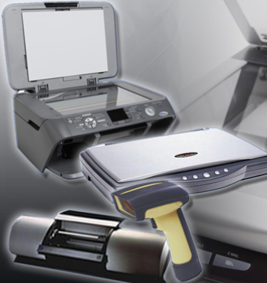
Types of Scanners
Technicians may be required to purchase, repair, or maintain a scanner.
The following are tasks
that a customer may
request:
  Select a scanner
  Install and configure a
  scanner
  Troubleshoot a scanner
Notes:
7.3 Describe the types of scanners currently available
As a computer technician, you may be required to purchase, repair, or maintain a scanner.
The following are tasks that a customer may request from you:
Select a scanner
Install and configure a scanner
Troubleshoot a scanner
After completing this section, students will meet the following objectives:
Describe scanner types, resolution, and interfaces
Describe all-in-one devices
Describe flatbed scanners
Describe handheld scanners
Describe drum scanners
Compare costs of different types of scanners.

Slide 17
Scanners
  Scanners typically create an RGB image that can be converted into image formats such as JPEG, TIFF, Bitmap, and PNG.
Some scanners can create text documents using optical character recognition (OCR).
  Resolution of a scanner is measured in dots per inch (dpi). Like printers, the higher the dpi, the better the quality of the image.
Interfaces and cables used for scanners are typically the same as those used for printers: Parallel, USB, SCSI, and Firewire.
Notes:
7.3.1 Describe scanner types, resolution, and interfaces
A scanned image can be saved, modified, and even e-mailed as you would with any other file.
RGB channels (red, green and blue) generally follow the color receptors of the human eye.
Some scanners can create text documents using optical character recognition (OCR). OCR software is used to convert a scanned printed page into text that can be edited with a word processor. Resolution of a scanner is measured in dots per inch (dpi). Like printers, the higher the dpi, the better the quality of the image.
To allow communication of data, the scanner and computer must have compatible interfaces.

Slide 18
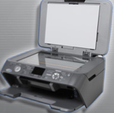
All-in-one Scanners
An all-in-one device combines the functionality of multiple into one physical piece of hardware (scanner, printer, copier and fax).
Normally this type of devices are not expensive and easy to configure. Unfortunately they are usually no designed for heavy use and a single problem can affect all the functionality.
Notes:
7.3.2 Describe all-in-one devices
All-in-one devices generally include these functions: scanner, printer, copier, and fax. The devices may also include media card readers and hard drives for storage.
All-in-one devices are typically used in home-office environments or where space is limited. These devices are often used with a computer but can operate alone to copy and fax documents.
Advantages:
All devices are built in
Low cost
One upgrade for all devices
Easy connection and setup
Uses one port for all devices
Disadvantages:
One problem effects all devices
Not designed for heavy use

Slide 19

Flatbed Scanners
Often used to scan books and photographs for archiving.
Image is acquired by placing the document face down on the glass. The scanner head lies beneath the glass and moves along the item, capturing the image.
The glass should be maintained clean and protected from scratching.
Notes:
7.3.3 Describe flatbed scanners
Sheet feeders can be used with flatbed scanners to scan multiple pages automatically. Flatbed scanners are often used to scan books and photographs for archiving. The scanner head, consisting of an array of image sensors, lies beneath the glass and moves along the item, capturing the image.
A sheet feeder is a device that can be attached to some flatbed scanners to hold multiple sheets and feed them into the scanner, one at a time. This feature allows for faster scanning; however, the image quality is usually not as good as a flatbed scanner that does not use a sheet feeder.
Maintenance:
Keep flatbed scanning glass clean.
Avoid placing items in the scanner that can scratch the glass surface, for example, staples.

Slide 20
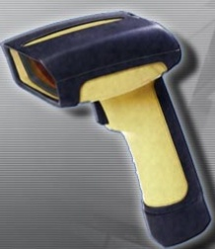
Handheld Scanners
A handheld scanner is small and portable.
Pass the scanner head across the surface you want to scanner.
When you want to scan an
item larger than the head of
the handheld scanner, you
must make more than one
pass to capture the full image.
Notes:
7.3.4 Describe handheld scanners
When you want to scan an item larger than the head of the handheld scanner, you must make more than one pass to capture the full image and then put the images back together to form a single image of the item that was scanned.
The images must be put back together to form a single image of the item that was scanned. It may be difficult to recreate the original image digitally when it is scanned in more than one pass.

Slide 21
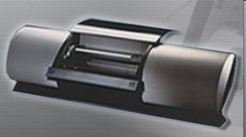
Drum Scanners
Drum scanners produce a high-quality scanned image, but they are being replaced by lower priced, high-quality flatbed scanners.
Still in use for high-end reproductions, such as archiving photographs in museums.
To scan an image using a drum scanner you should attach the image to a revolving drum or load it into a supporting canister.
Notes:
7.3.5 Describe drum scanners
Drum scanners
Produce a high-quality scanned image
Usually used in commercial operations
Being replaced by lower priced, high-quality flatbed scanners
Still in use for high-end reproductions, such as archiving photographs in museums
To scan an image using a drum scanner:
Attach the image to a revolving drum or load it into a supporting canister.
Drum is rotated at high speed across optical scanners.
Optical scanners move slowly across the drum surface until the entire image is captured.
The captured image is then reproduced by the computer as a digital image file.

Slide 22
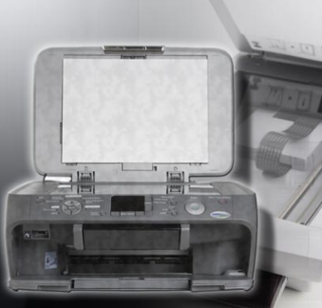
Installation and Configuration of Scanners
An installation media includes drivers, manuals, and diagnostic software will be included with the scanner.
The same tools may also be available as downloads from the manufacturer's website.
Notes:
7.4 Describe the installation and configuration process for scanners
When you purchase a scanner, the installation and configuration information is usually supplied by the manufacturer. An installation CD that includes drivers, manuals, and diagnostic software will be included with the scanner. The same tools may also be available as downloads from the manufacturer's website.

Slide 23
Installation and Configuration of Scanners (Continued)
Power and Connect the Scanner
  Scanners can connect to a computer using a USB, FireWire, network, parallel port or a SCSI interface.
  Warning: All-in-one devices that include printers must connect directly to AC power because of the heavy current demands of the printer.
Scanner Driver
  Printer driver is the software program that enables the computer and the printer to communicate with each other.
  Once the scanner is connected and started, the computer operating system may be able to discover the scanner through the Plug and Play (PnP) process.
Configuration Options and Default Settings
  A scanner may come with applications such as Graphic software for editing photographs and other images or OCR software.
  Some configurations that may be available on a scanner are:
    Color, grayscale, or black-and-white scanning, One-touch scanning into your choice of software, Quality and resolution choices and Sheet feeders
Notes:
7.4.1 Explain how to power and connect a scanner
Scanners that do not include a printer can connect using an AC power adapter, much like a laptop.
Some scanners can draw all the power they need from the USB or FireWire connector.
After unpacking the scanner, connect the appropriate power and data cables. Use the scanner documentation as your guide, or check the manufacturer's website for instructions.
CAUTION: Some scanners are packed for shipping with the scanner assembly taped or blocked off. This prevents it from being damaged in transport and must be freed before the scanner will operate. See the user's guide, documentation, or the manufacturer's website for unpacking instructions.
7.4.2 Describe how to install and update the device driver
A driver may be installed automatically by the operating system.
After you set up a scanner, install the driver software that the manufacturer includes with the scanner.
This driver is usually more current than the ones on your computer.
It may also provide more functionality than the basic driver from Windows.
You may want to install drivers from the manufacturer's website to gain additional functionality, diagnostic tools, and troubleshooting utilities.
Student Activity: The student course content includes a lab, 7.4.2 Install All-in-One Device and Software. To complete this lab, students will install an all-in-one device. Find, download, and update the driver and the software for the all-in-one device.
7.4.3 Identify configuration options and default settings
Color calibration between devices is important so that you see true representations of color. To calibrate a scanner, scan a graphic that contains specific colors. A calibration application compares the output of the scanner against the known colors of the sample graphic on the display. The software will adjust the color of the scanner accordingly. When your scanner, monitor, and printer treat the same colors in the same way, the image you print will match the image you scan.

Slide 24
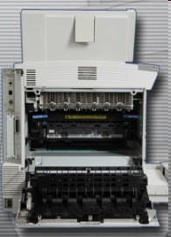
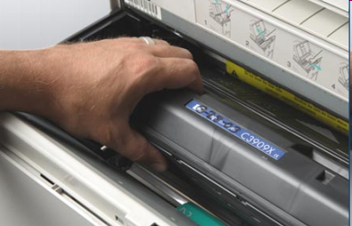
Preventive Maintenance Techniques
Printers and scanners have many moving parts that can wear out over time or through extended use.
Also moving parts can be affected by dust and other particles.
Clean printers and scanners regularly to avoid downtime, loss of productivity, and high repair costs.
Notes:
7.5 Identify and apply common preventive maintenance techniques for printers and scanners
Printers and scanners have many moving parts that can wear out over time or through extended use. Moving parts can be affected by dust and other particles. Clean printers and scanners regularly to avoid downtime, loss of productivity, and high repair costs.

Slide 25
Preventive Maintenance Techniques (Continued)
Printer Maintenance
  Printers have many moving parts and require more maintenance than most electronic devices.
  CAUTION: Unplug the printer from the electrical source before beginning maintenance.
Paper and Ink
  Using the correct type of paper can help you to ensure that the printer operates longer and prints more efficiently.
  Types of printer paper available include inkjet and laser. Some papers, especially photo paper and transparencies, have a right and wrong side marked by an arrow on the package.
  Manufacturer will recommend the brand and type of ink to use. Do not refill ink cartridges because the ink may leak.
Notes:
7.5.1 Describe printer maintenance
Impurities are produced by the printer and collect on the components. Over time, if the impurities are not removed, the printer may malfunction. A maintenance schedule for a printer can be found in the manual or on the manufacturer's website.
CAUTION: Unplug the printer from the electrical source before beginning maintenance.
Techniques for maintaining printers:
Printer monitoring and diagnostic software from the manufacturer can run various maintenance tasks.
Dot matrix printers have roller surfaces that you should clean with a damp cloth.
Inkjet printers have paper-handling mechanisms that may collect particles of paper over time. Wipe the area with a damp cloth.
Clean a laser printer with a special vacuum cleaner (not a household type) if you spill the toner. Toner particles will go through the filter of a household vacuum and into the air.
Unplug a laser printer before cleaning it due to the high voltages.
The paper and the ink used in a printer are important for the following reasons:
Paper selection - Many types of printer paper are available, including inkjet and laser. Paper packages are usually labeled with the type of printer for which it is intended. The manufacturer may recommend the type of paper that should be used for best results.
Ink selection - If the wrong type of ink is installed, the printer may not work or the print quality may be reduced. You should avoid refilling the ink cartridges because the ink may leak.

Slide 26
Preventive Maintenance Techniques (Continued)
Scanner Maintenance
  The scanner surface should be kept clean. If the glass becomes dirty, consult the manufacturer's user manual.
  If the inside of the glass becomes dirty, check the manual for instructions on how to open the unit or remove the glass from the scanner.
  When the scanner is not in use, keep lid
  closed.
  Never lay anything heavy on a scanner.
Notes:
7.5.2 Describe scanner maintenance
The scanner surface should be kept clean.
If the glass becomes dirty, consult the manufacturer's user manual for cleaning recommendations.
To prevent liquid from leaking into the scanner case, do not spray glass cleaner directly on the device. Dampen a cloth with cleaner, and then apply gently to the glass.
If possible, clean both sides of the glass.
When the scanner is not in use, keep lid closed.
Never lay anything heavy on a scanner.
Store handheld scanners in a safe place.

Slide 27
Troubleshooting Printers and Scanners
Step 1 Identify the problem
Step 2 Establish a theory of probable causes
Step 3 Determine an exact cause
Step 4 Implement a solution
Step 5 Verify solution and full system functionality
Step 6 Document findings
Notes:
7.6 Troubleshoot printers and scanners
With printer and scanner problems, a technician must be able to determine if the problem exists with the printer, the scanner, the cable connection, or the attached computer.
Follow the steps outlined in this section to accurately identify, repair, and document the problem:
Step 1 Identify the problem
Step 2 Establish a theory of probable causes
Step 3 Determine an exact cause
Step 4 Implement a solution
Step 5 Verify solution and full system functionality
Step 6 Document findings

Slide 28
Step 1 - Identify the Problem
Printer or scanner information
  Manufacturer, model, OS, network environment, connection type
Open-ended questions
  What problems are you experiencing with your printer or scanner?
  What software or hardware has been changed recently on your computer?
  What were you doing when the problem was identified?
  What error messages have you received?
Closed-ended questions
  Is the printer under warranty?
  Can you print a test page?
  Is this a new printer?
  IS the printer powered on?
Notes:
7.6.1 Review the troubleshooting process
Identify the Problem
When a customer is not able to accurately describe the problem, there are other ways to evaluate the situation in the next steps of the troubleshooting process.

Slide 29
Step 2 - Establish a Theory of Probable Causes
Problem may be simpler than the customer thinks.
Create a list of the most common reasons why the error would occur.
  Loose cable connections
  Errors on equipment display
  Errors on computer screen
  Equipment power
  Out of paper
  Printer queue
  Paper jams
  Low ink warning
Notes:
7.6.1 Review the troubleshooting process
Establish a Theory of Probable Causes

Slide 30
Step 3 - Determine the Exact Cause
Testing your theories of probable causes one at a time, starting with the quickest and easiest.
  Restart the printer or scanner
  Disconnect and reconnect the cables
  Restart the computer
  Check printer for paper jams
  Reseat paper in paper trays
  Open and close printer trays
  Ensure printer doors are closed
  Install a new link or toner cartridge
If the exact cause of the problem has not been determined after you have tested all your theories, establish a new theory of probable causes and test it.
Notes:
7.6.1 Review the troubleshooting process
Determine the Exact Cause
There are several hardware solutions that you can try:
You may also try software solutions to determine the solution:
Print from another application
Remove all print jobs from the queue. To do this, follow this path:
Start > Printers and Faxes > double-click the printer > Printer > Cancel All Documents (Windows XP)
Start > Control Panel > Printers > double-click the printer > Printer > Cancel All Documents (Windows Vista)

Slide 31
Step 4 - Implement a Solution
Sometimes quick procedures can determine the exact cause of the problem or even correct the problem.
If a quick procedure does not correct the problem, you might need to research the problem further to establish the exact cause.
Divide larger problems into smaller problems that can be analyzed and solved individually.
Notes:
7.6.1 Review the troubleshooting process
Implement a Solution
If a quick procedure does correct the problem, you can go to step 5 to verify the solution and full system functionality.
Evaluate the problem and research possible solutions. Divide larger problems into smaller problems that can be analyzed and solved individually. Prioritize solutions starting with the easiest and fastest to implement.
Check:
Helpdesk repair logs
Other techs
Manufacturer FAQs
Technical websites
News groups
Computer manuals
Device manuals
Online forums
Internet search

Slide 32
Step 5 - Verify Solution and System Functionality
Verifying full system functionality and implementing any preventive measures if needed. Ensures that you have not created another problem while repairing the computer.
  Reboot the computer
  Reboot the printer
  Print a test page from the printer control panel
  Print a document from an application
  Reprint the customer’s problem document.
Have the customer verify the solution and system functionality.
Notes:
7.6.1 Review the troubleshooting process
Verify Solution and System Functionality

Slide 33
Step 6 - Document Findings
Discuss the solution with the customer
Have the customer confirm that the problem has been solved
Document the process
  Problem description
  Solution
  Components used
  Amount of time spent in solving the problem
Notes:
7.6.1 Review the troubleshooting process
Document Findings

Slide 34
Common Problems and Solutions
Printer and scanner problems can be attributed to hardware, software, networks, or some combination of the three. You will resolve some types of printer and scanner problems more often than others.
Notes:
7.6.2 Common Problems and Solutions
[Direct the students to the curriculum to see all the charts explaining more common problems and solutions]
Printer or scanner problems can be attributed to hardware, software, networks, or some combination of the three. You will resolve some types of printer and scanner problems more often than others.
Other common printer problems and possible causes to consider:
Problem: Page is blank
Possible causes might be toner is empty, transfer corona assembly is malfunctioning, or the high voltage power supply which powers the charging and corona assemblies is malfunctioning
Problem: Page is completely black
Possible cause might be charging corona wire is malfunctioning
Problem: Recurring marks on page
Possible causes might be damage to the drum or toner spilled on one of the rollers.
Problem: Vertical black lines on page
Possible causes might be damage to the drum and dirty charging corona wire
Problem: Vertical white lines on page
Possible cause might be spilt toner on the charging corona wire
Problem: Smudging of image
Possible cause might be fuser is malfunctioning
Problem: Ghosting of image
Possible cause might be damaged cleaning scraper
Problem: Unintelligible text
Possible causes might be printer driver is malfunctioning or formatter board is malfunctioning

Slide 35
Chapter 7 Summary
Some printers and scanners have low output and are adequate for home use, while other printers and scanners have high output and are designed for commercial use.
Printers may have different speeds and quality of print. There is also a difference in price between the types of printers.
Scanners have specific applications. The drum scanner is the most expensive.
Notes:
Chapter 7 Summary

Slide 36
Chapter 7 Summary
Older printers and scanners use parallel cables and ports. Newer printers and scanners typically use USB or Firewire cables and connectors. Larger printers and scanners may also have an NIC port to connect to a network.
Newer printers and scanners are PnP, and need only be connected to the computer. The computer will automatically install the necessary drivers.
If the device drivers are not automatically installed by the computer, you will have to supply the drivers on a CD or download from the manufacturer website.
Notes:
Chapter 7 Summary

Slide 37
Chapter 7 Summary
Most optimization is done through software drivers and utilities. For example, print spool settings on the computer can be changed depending on the amount of available RAM on the computer.
Once you have set up the printer or scanner, you can share the device to other users on the network. This is cost-efficient as there is no need for every user to have a printer or scanner.
It is important to know how to properly configure local and networked printers, as well as which options are automatically installed through PnP.
Notes:
Chapter 7 Summary

Slide 38
Chapter 7 Summary
A good preventative maintenance program will extend the life of the printer or scanner and keep them performing well.
Troubleshooting printer and scanner problems requires the technician to identify, repair, and document the problem.
Troubleshooting steps include: identify the problem, establish a theory of probable causes, determine an exact cause, implement a solution, verify solution and full system functionality, and document findings.
Notes:
Chapter 7 Summary

Slide 39


